Slide 1
Analysis on Patient’s Mental health Visits
Waypoint Interview Presentation
Arpan Kanani

Slide 2
Contents
Understanding Patient Trends
Dashboard Representation
Dashboard Visuals and Insights Overview

Slide 3
Understanding Patient Trends
Distribution Across Triage Levels:
Explore the distribution of visits across triage levels to understand patient urgency and resource allocation.
Monthly Visit Patterns:
Uncover how visit frequency evolves month by month, shedding light on temporal healthcare demands.
Gender Disparities in Triage:
Investigate if there are notable differences in triage level distribution between genders, offering insights into healthcare needs.
Triage Level and Diagnosis Severity:
Analyze the correlation between triage level and diagnosis severity to optimize patient care pathways.
Outlier Detection in Patient Visits:
Identify outliers in visits per patient, allowing for targeted intervention and care optimization.

Slide 4
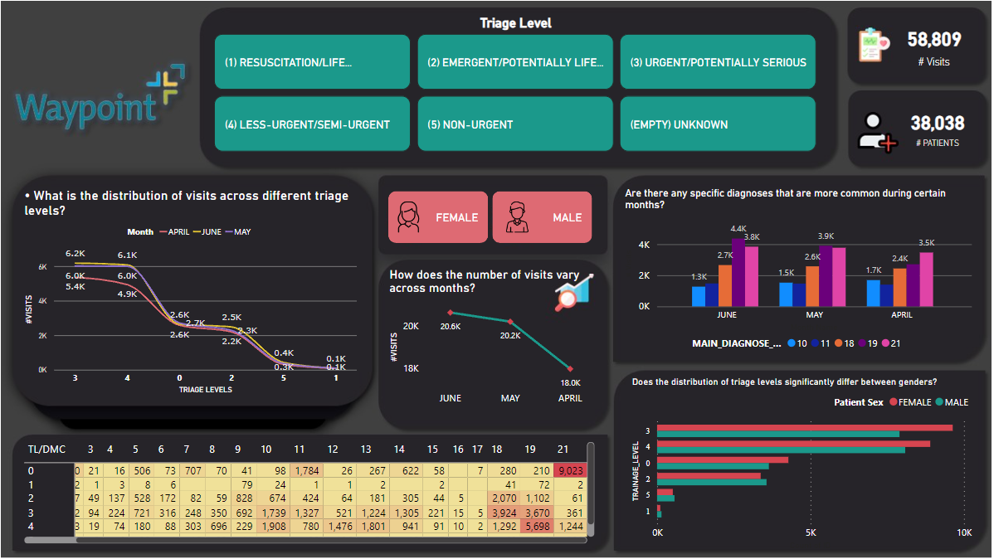

Slide 5
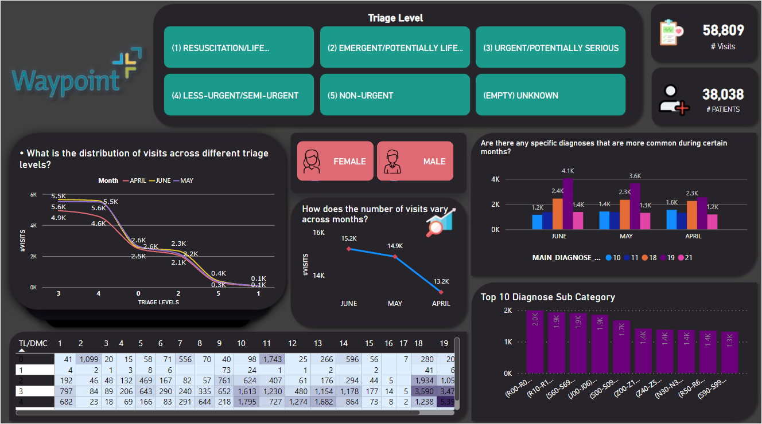

Slide 6
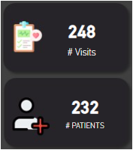
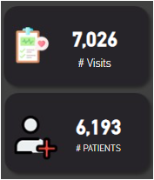
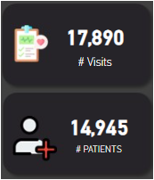
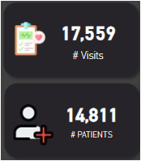
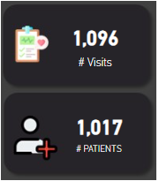
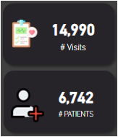
Distribution across triage levels
2 Peculiar Insights
Level 1
Level 2
Level 3
Level 4
Level 5
Level 0/ Unknown

Slide 7
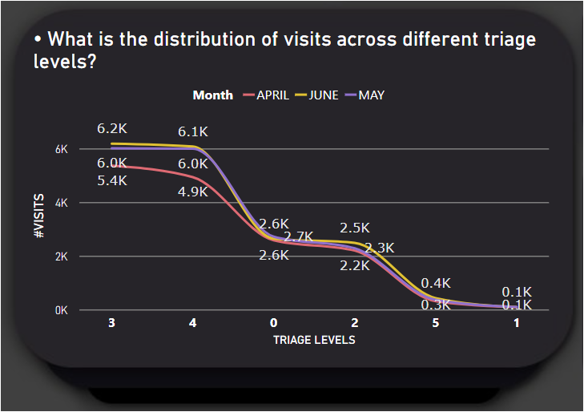
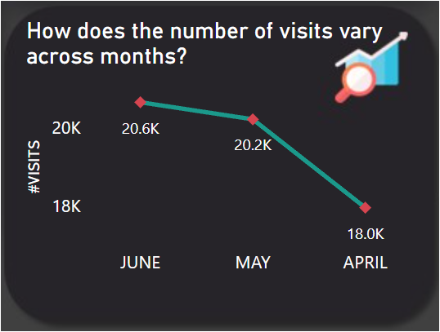
Monthly Visit Pattern

Slide 8
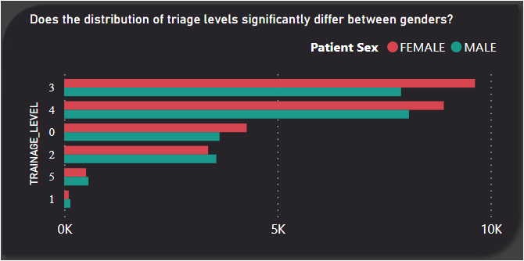
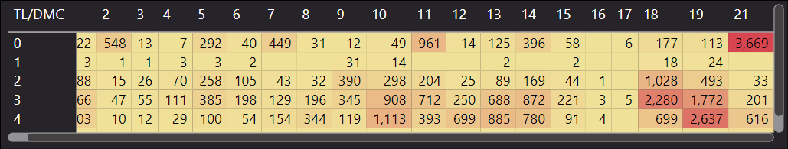
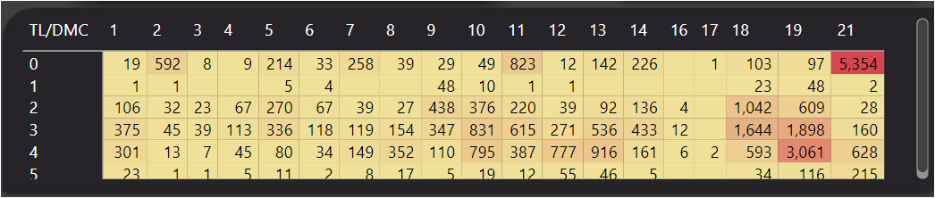
Gender Analysis
Are there any distinctive gender-specific trends?
For Females Visits for 18,19,21 DMC are Higher.
For Males Visits for 19,21 DMC are Significantly Higher (far more than females).
FEMALE COUNT : TRIAGE LEVEL 3, 4, 0 MALE COUNT : TRIAGE LEVEL 1, 2 , 5

Slide 9
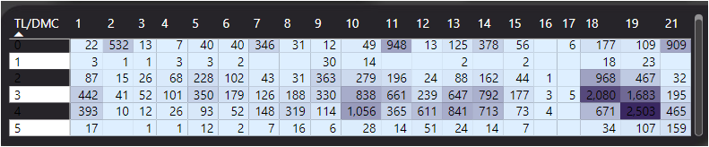
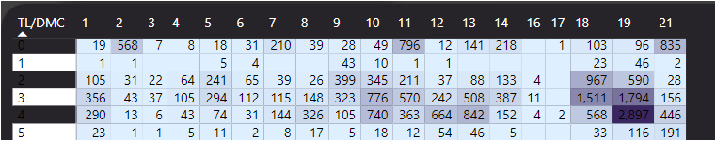
FEMALE ANALYSIS
MALE ANALYSIS

Slide 10
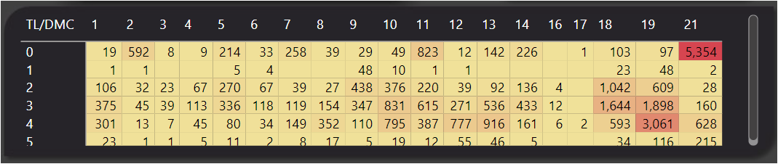
Is there any Correlation between TL & DMC
KEY NOTES:
From the Heat map we can see that all the DMC have diversified visits over various TL.
Abbreviations TL : Triage Level DMC : Diagnose Manin Category

Slide 11
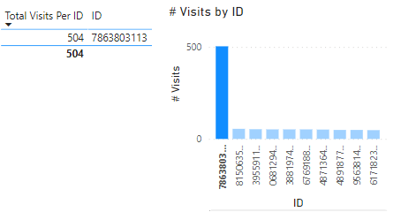
Outlier Detection
ID : 7863803113 Has 500 visits in time- period of 3 months. That doesn't sound practical.
Secondly, there was only 1 case where Patient sex was “UNDIFFERENTIATED (STILLBIRTHS ONLY)” which could be ignored as it would have no major impact on our analysis.

Slide 12

QUESTIONS????

